Slide 1


Dr. Muzamil Ahmed (Assistant Professor) Namal University Mianwali
Natural Language Processing
Word Vectors
DEEP Learning

Slide 2

Lesson from Quran

Slide 3

Lecture Outline
Distributional semantics hypothesis
Word Embeddings: Timeline
Word Vectors
Word2Vec: CBOW
Word2Vec: Skip-gram
Skip-gram with negative sampling
Word2Vec: Training process
fastText and GloVev
Embedding Space
Contextual Embeddings

Slide 4
Distributional semantics hypothesis
Word Embeddings
Never ask for the meaning of a word in isolation, but only in the context of a sentence (Frege, 1884)
For a large class of cases... the meaning of a word is its use in the language (Wittgenstein, 1953)
You shall know a word by the company it keeps (Firth, 1957)
Words that occur in similar contexts tend to have similar meaning (Harris, 1954)

Slide 5
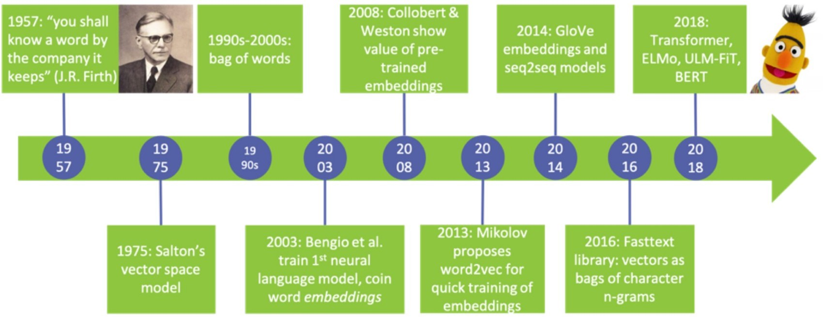
Word Embeddings: Timeline
Word Embeddings

Slide 6
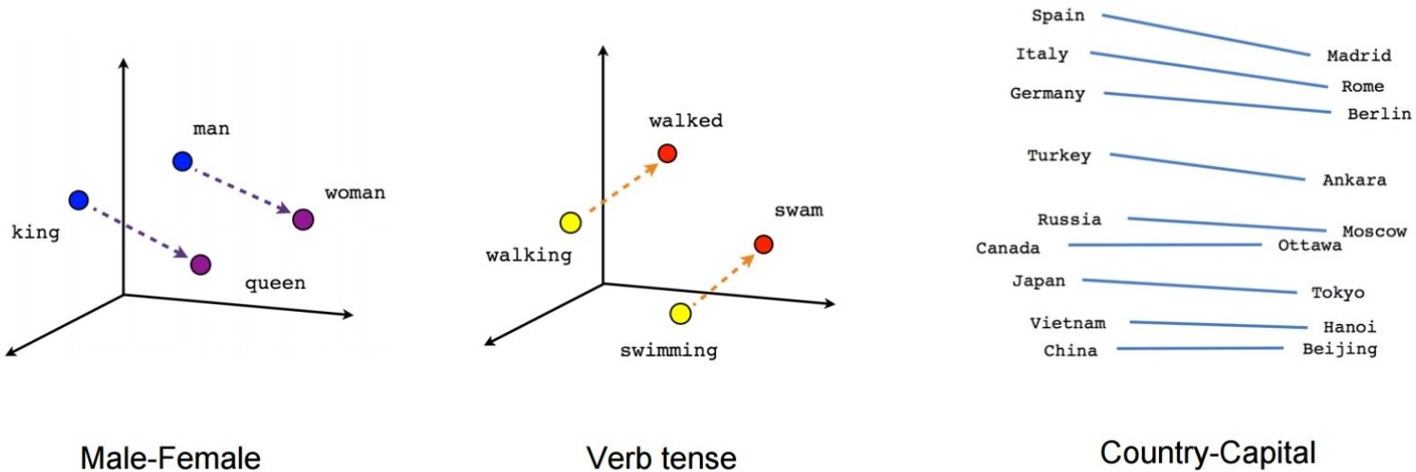
Word Vectors
Word Embeddings

Slide 7
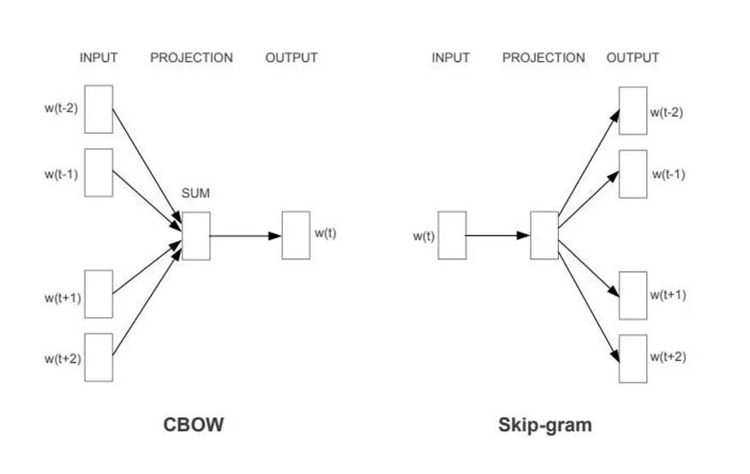
Word2Vec (Mikolov 2013)
Word Embeddings > Word2Vec
2 methods to pretrain embeddings
●
CBOW (Continuous bag-of-words)
Train a NN that given a set of context words, learns to predict the missing one.
Skip-gram
–
●
– Train a NN that given a word, learns to predict likely words in its context.

Slide 8
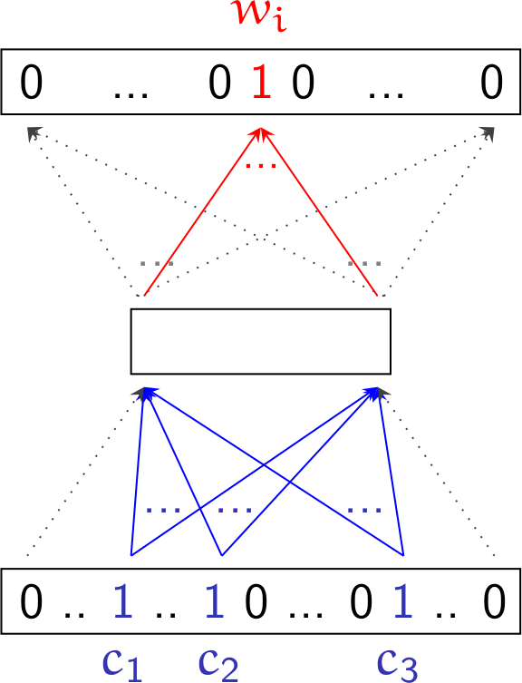
Word2Vec: CBOW
Word Embeddings > Word2Vec > CBOW
CBOW
A dense low-rank vector representing a word is extracted from the internal representation of a Neural Network.
●
–
Word context words c1, c2, c3 appearing around word
wi are used as a training example.
The NN is trained to predict the missing word for a given input context.
The hidden layer input weights encode the distribution of likely words in each context.
Words appearing in similar contexts will have similar hidden layer weights.
Hidden layer weights for each word are used as their dense vector representation
–
–
–
–

Slide 9
Word2Vec: CBOW
Word Embeddings > Word2Vec > CBOW
CBOW
c : input vector, context words
V : input layer weights
hc : hidden layer state for input c
T
●
w
∑
∑
i : c_{i} =1
h =V⋅c=
V ⋅c=
V
T
i
zi
c
i
i
U
●
U : hidden layer weights
z : output scores
z_{i} =U _{i}⋅h_{c}
h
V
●
Softmax to convert scores to prob. distribution
exp( z_{i} ) exp(U _{i}⋅h_{c} )
v1
v2
v3
w =
=
i
∑exp( z ) ∑exp(U ⋅h )
c
j j c
j j

Slide 10
Word2Vec: CBOW
Word Embeddings > Word2Vec > CBOW
CBOW
●
Training: Use cross entropy of estimated probability distribution Q(w) with respect to gold distribution P(W)
=E_{P} [−log Q (w )]=−∑_{w} P ( w )log Q( w )
=E_{P} [−log Q (w )+log P ( w )−log P (w )]
P (w )
CE (P ,Q)
w
zi
=E_{P} [ log _{Q (w )} ]+ E_{P} [−log P (w )]
U
=D_{KL} ( P Q)+ H (P )
In our case equals to minimizing the negative log- likelihood of the target vector given the context
h
●
=−∑_{w} P (w ) log Q (w )=−1⋅log Q (w_{i}∣c)
_{=−log} exp(U _{i}⋅h_{c} )
V
Loss
v1
v2
v3
∑_{j} exp(U _{j}⋅h_{c} )
=−U_{i}⋅h_{c} + log∑_{j} exp(U _{j}⋅h_{c} )
c
Notes:
P(w) = true distribution
Q(w) = predicted distribution by the model
P(w) is target word distribution (one-hot vector) Q(w) is softmax output probabilities Only correct word probability matters. Example:
$$P=0.9$$
Then:
$$−log⁡\left(0.9\right)=0.10$$
Small loss
In CBOW, because the target is one-hot encoded, cross-entropy reduces to negative log probability of the correct target word.

Slide 11
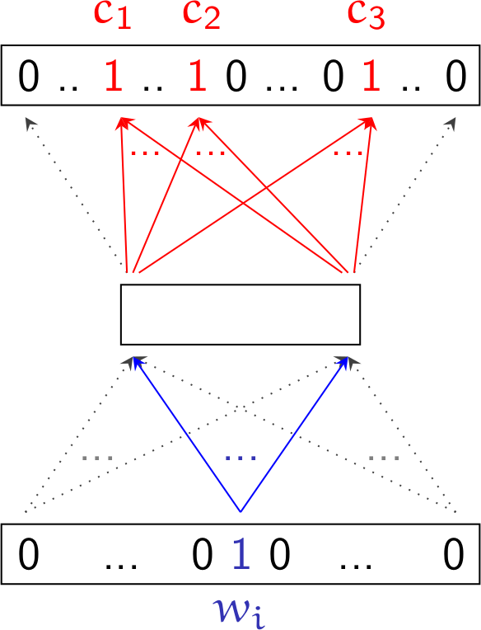
Word2Vec: Skip-gram
Word Embeddings > Word2Vec > Skip-gram
Skip-gram
A dense low-rank vector representing a word is extracted from the internal representation of a Neural Network.
●
–
Word wi appearing near context words c1, c2, c3 is used as a training example.
The NN is trained to predict usual context words for a given input word.
The hidden layer input weights encode the usual contexts of each input word.
Word appearing in similar contexts will have similar hidden layer weights.
Hidden layer weights for each word are used as their dense vector representation
–
–
–
–

Slide 12
Word2Vec: Skip-gram
Word Embeddings > Word2Vec > Skip-gram
Skip-gram
BUT:
●
–
The size of the vocabulary is usually large (e.g. 10,000 words)
If the hidden layer has, e.g. 300 dimensions, that means 300 x 10,000 x 2 parameters to update for each training example.
–
Too high computational cost

Slide 13
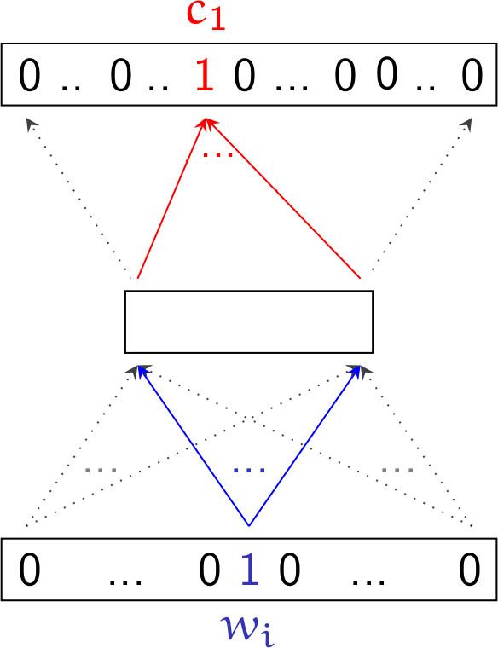
Word2Vec: Skip-gram
Word Embeddings > Word2Vec > Skip-gram
Skip-gram
We show the network only one target word at a time, so the amount of parameters to update is much smaller
But...
●
If we use only positive examples, the network will overgeneralize and may end up assigning prob 1 to all words
We need to introduce negative examples

Slide 14
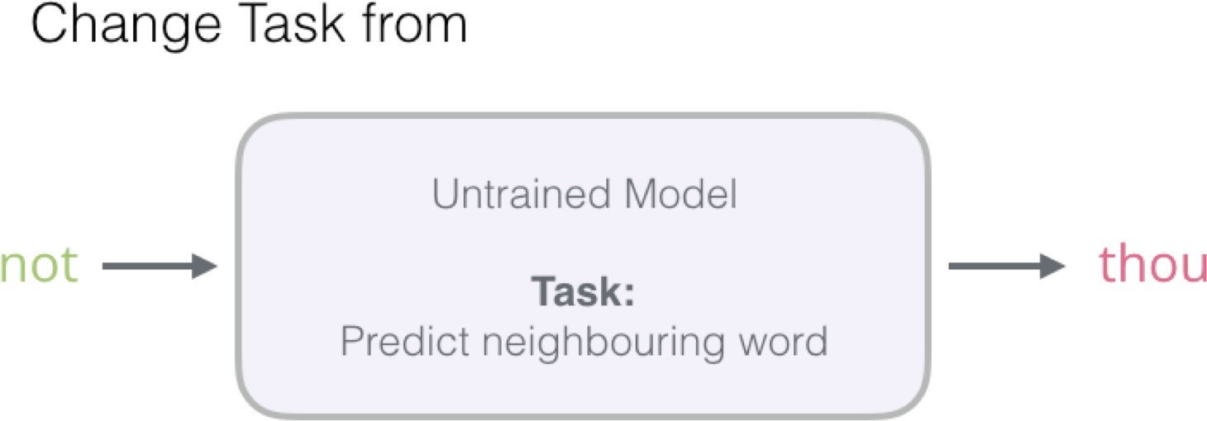
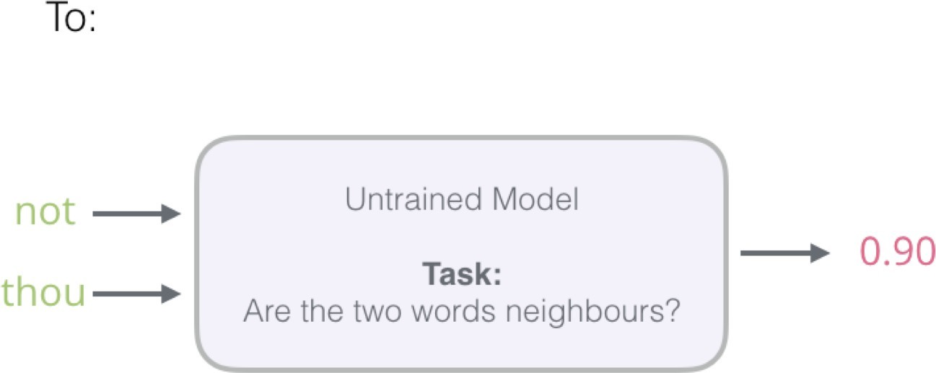
Skip-gram with negative sampling
Word Embeddings > Word2Vec > Skip-gram training
●
We change the task to predict whether the words belong in the same context (0 or 1)

Slide 15
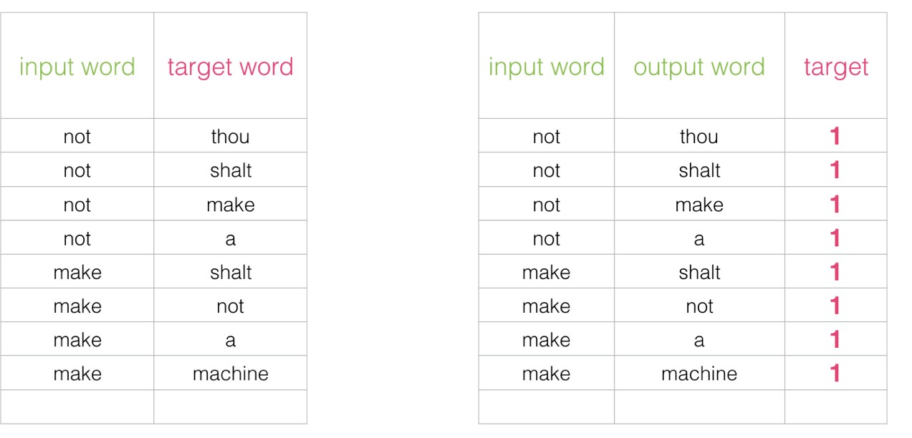
Negative examples
Word Embeddings > Word2Vec > Skip-gram training
●
This can computed very efficienty – processing millions of examples in minutes.
We can afford to introduce some negative examples at a resonable cost
●

Slide 16
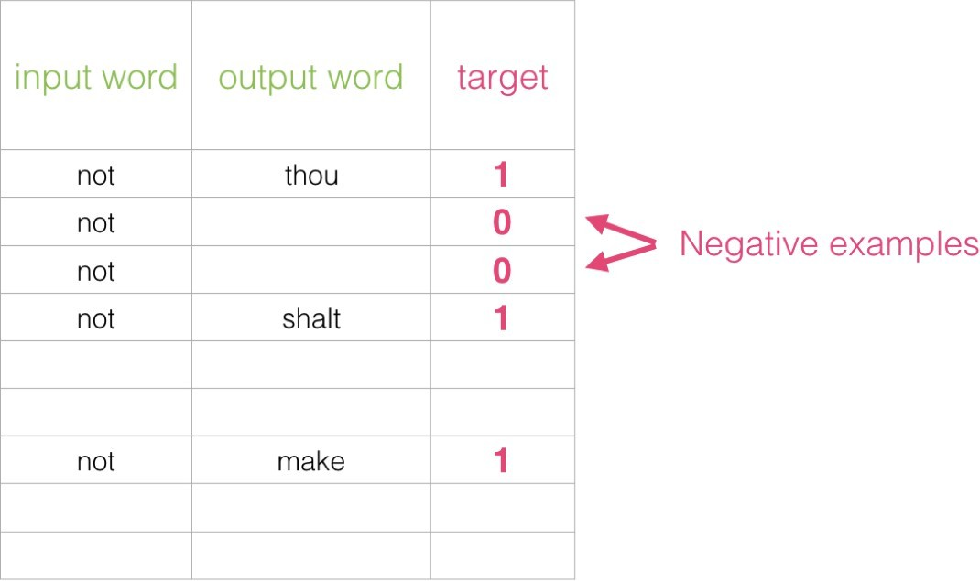
Negative examples
Word Embeddings > Word2Vec > Skip-gram training
●
We add a few negative examples for each positive pair in the dataset, with the same input word, a non-related context word, and a 0 label.
We are contrasting the actual signal (positive examples of neighboring words) with noise (randomly selected words that are not neighbors), allowing the model to learn a trade-off.

Slide 17
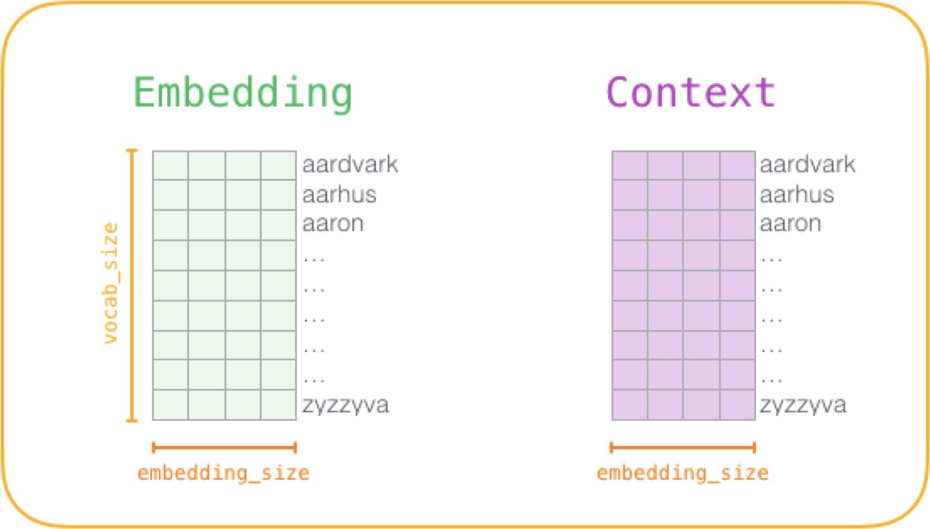
Training process
Word Embeddings > Word2Vec > Skip-gram training
1) Pre-process the training text:
●
Determine model vocabulary (which words are to be included in the model, and which will be the size of the model (number of vectors) |V|
Decide the dimension of the embedding E. Usual values are 100, 200, 300...
●
2) Create two matrices:
●
Embedding matrix |V|xE
Context matrix: |V|xE
●
Both matrices have an entry for each word in the vocabulary.
Both are initialized with random values.

Slide 18
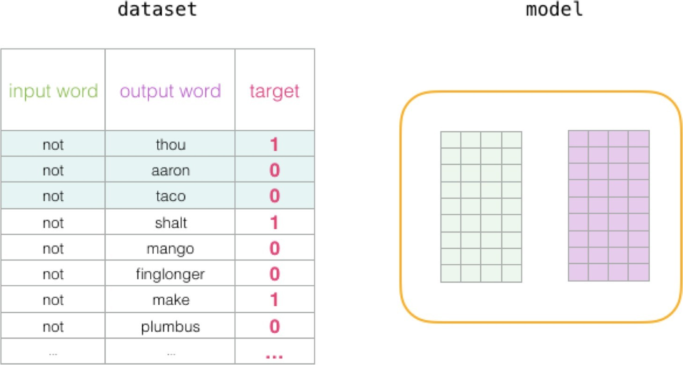
Training process
Word Embeddings > Word2Vec > Skip-gram training
●
In each training step, we take one positive example and its associated negative examples.

Slide 19
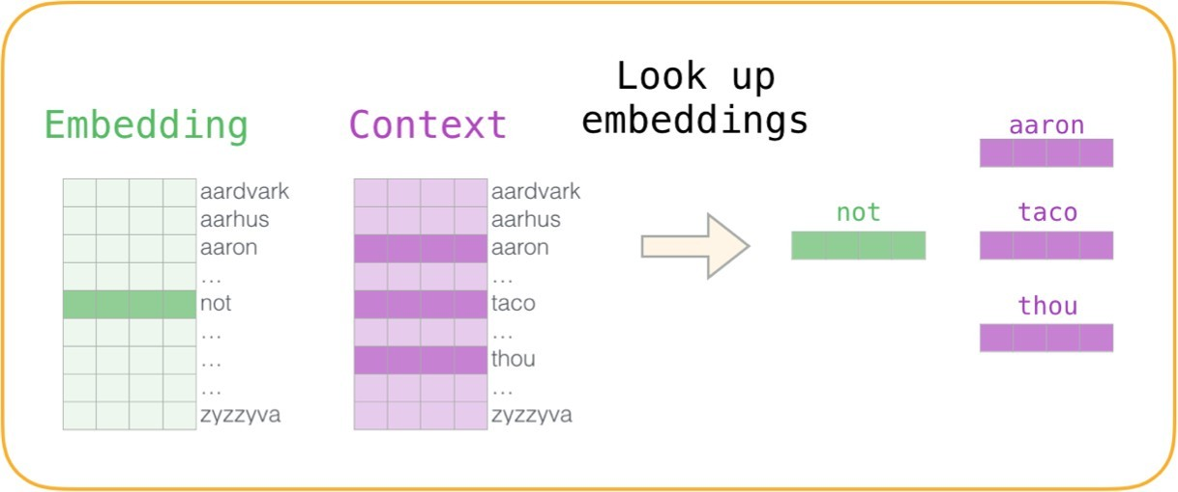
Training process
Word Embeddings > Word2Vec > Skip-gram training
●
For each eaxample, we have four words:
–
–
input word: not
output/context words:
●
thou (actual neighbor)
aaron, taco (negative examples).
●
●
Step 1: Look up current embeddings
–
For input word, we look up in the Embedding matrix.
For context words, we look up in the Context matrix
–

Slide 20
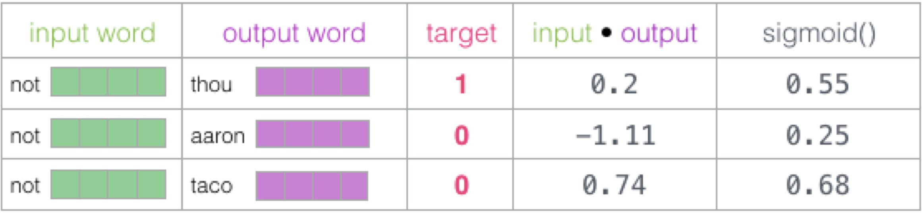
Training process
Word Embeddings > Word2Vec > Skip-gram training
●
Step 2:
–
Compute the dot product of the input word embedding with each of the context words embeddings, obtaining a similarity value
Use sigmod to convert these scores to probabilty-like values
–
Note that taco has the highest score and aaron still has the lowest score both before and after the sigmoid operations.

Slide 21
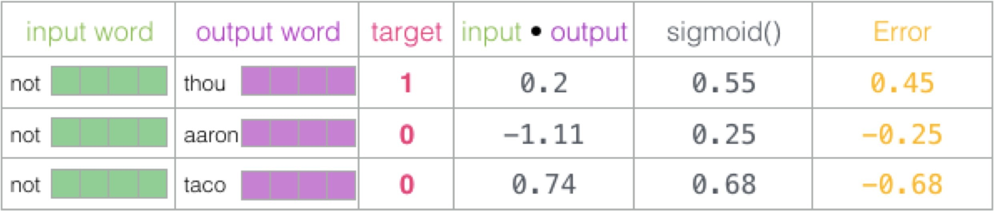
Training process
Word Embeddings > Word2Vec > Skip-gram training
Step 3:
– Compute error in the model prediction.
(subtract the sigmoid scores from the target labels)
●

Slide 22
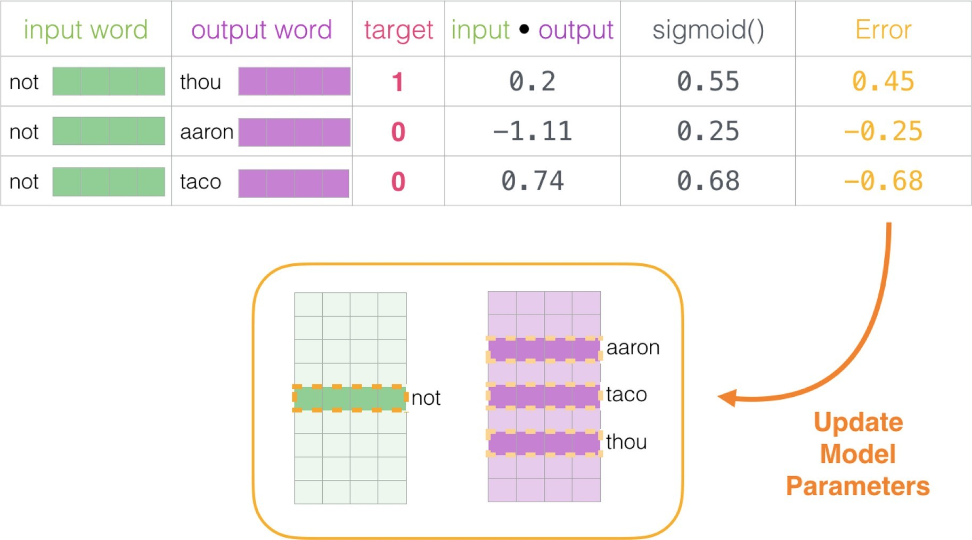
Training process
Word Embeddings > Word2Vec > Skip-gram training
●
Step 4: Update model.
Use error score to adjust the embeddings of not, thou, aaron, and taco
so that the next time the result would be closer to the target scores

Slide 23
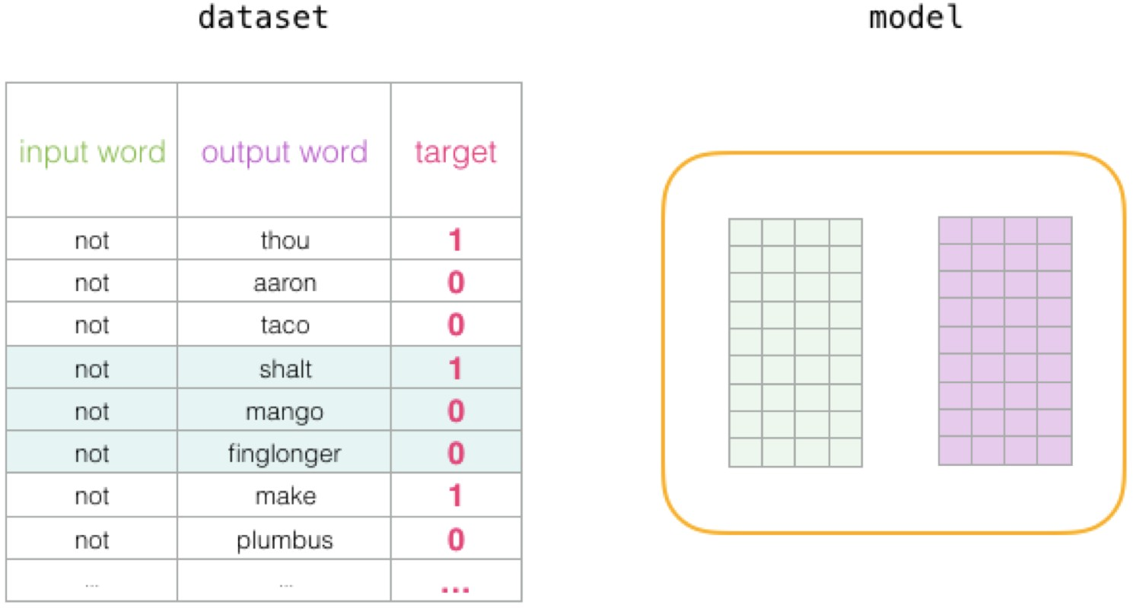
Training process
Word Embeddings > Word2Vec > Skip-gram training
●
After processing this example, embeddings for the words involved in this step are slightly improved. We can proceed to the next example and repeat the process:
Cycle through the entire dataset a number of times (or epochs).
Finally, discard the Context matrix, and use the Embeddings matrix as our pre- trained embeddings model
●
●

Slide 24
Other methods: Not simply words
Word Embeddings > Other units
●
Instead of words, other units may be used:
–
Phrases: Washington_Post is a newspaper Phrases can be generated using counts, e.g.
P (w , w )
PMI =log ¹ ²
P (w₁ )⋅P (w₂)
–
Characters: W a s h i n g t o n _ P o s t _ i s _ a _ n e w s p a p e r Create an embedding for each character, word representations are created combining its character vectors.
–
Subwords: Wash #ing #ton Post is a new #spaper
Different strategies to decide what subwords are used: n-grams, Byte Pair Encoding (BPE), Wordpiece, Sentencepiece, ...

Slide 25
Other methods: fastText
Word Embeddings > fastText
●
fastText: Subword (n-gram) based skip-gram.
– Embedding vector for a word w is the sum of the embeddings of its n-grams (3≤n≤6 ).
e.g. The fastText representation of word where is the sum of 15 embedding vectors, for the n-grams:
–
grams: _wh, whe, her, ere, re_
grams: _whe, wher, here, ere_
grams: _wher, where, here_
grams: _where, where_ Whole word: _where_
●
●
●
●
●

Slide 26
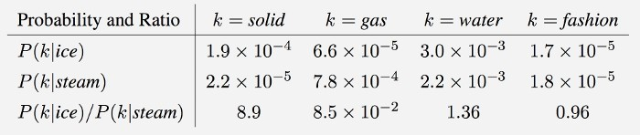
Other methods: GloVe
Word Embeddings > GloVe
GloVe: Global Vectors for Word Representation.
●
Ratios of word-word co-occurrence probabilities have the potential for encoding semantic similarity
Xij : occurrences of word j the context of word i
Xi : occurrences of any word in the context of word i
P ( j∣i )= ^{xij}
x_{i}

Slide 27
Other methods: GloVe
Word Embeddings > GloVe
GloVe: Global Vectors for Word Representation.
●
solid has a much higher co-occurrence probability with ice than with steam

Slide 28
Other methods: GloVe
Word Embeddings > GloVe
GloVe: Global Vectors for Word Representation.
●
gas has a much higher co-occurrence probability with steam
than with ice

Slide 29
Other methods: GloVe
Word Embeddings > GloVe
GloVe: Global Vectors for Word Representation.
●
water has a similar (high) co-occurrence probability with both ice
and steam

Slide 30
Other methods: GloVe
Word Embeddings > GloVe
GloVe: Global Vectors for Word Representation.
●
fashion has a similar (low) co-occurrence probability with both
ice and steam

Slide 31
Other methods: GloVe
Word Embeddings > GloVe
GloVe: Global Vectors for Word Representation.
●
Training: Learn two vectors for each word, such that we have a multinomial logistic regression of the the co-ocurrence probability
~
w ⋅w ≈log P ( j∣i)
i j
●
We can solve it minimizing :
L=∑ (w ⋅w~ −log P ( j∣i))²
i , j ∈V
i j
●
To reduce noise introduced by rare co-occurrences, the loss is actualy weigthed:
where f(Xij) is a weight in [0,1] that grows
L=∑ f ( X )(w ⋅w~ −log P ( j∣i ))²
i , j ∈V
ij
i j
with the co-occurrence frequency Xij

Slide 32
Other methods: GloVe
Word Embeddings > GloVe
GloVe: Global Vectors for Word Representation.
●
Stochastic gradient descent (SGD) is used to minimize the squared error between the dot product of word vectors and the logarithm of their co-occurrence count.
Once the model is trained, we have 2 vectors for each word
– wi : vector representing word i as the center word
●
– w~ : vector representing word i as a context word
i
~
●
Either one of them (or their sum w + w
representation vector.
) are used as the word
i
i

Slide 33
Other methods: GloVe
Word Embeddings > GloVe
GloVe: Global Vectors for Word Representation.
●
Stochastic gradient descent (SGD) is used to minimize the squared error between the dot product of word vectors and the logarithm of their co-occurrence count.
Once the model is trained, we have 2 vectors for each word
– wi : vector representing word i as the center word
●
– w~ : vector representing word i as a context word
i
~
No neural net involved
●
Either one of them (or their sum w + w
representation vector.
) are used as the word
i
i

Slide 34
Other methods: GloVe
Word Embeddings > GloVe
GloVe: Global Vectors for Word Representation.
●
GloVe captures both local and global statistical information from text.
More effective for analogy tasks due to its explicit modeling of word relationships.
●
●
Often results in better embeddings for uncommon words compared to Word2Vec.

Slide 35
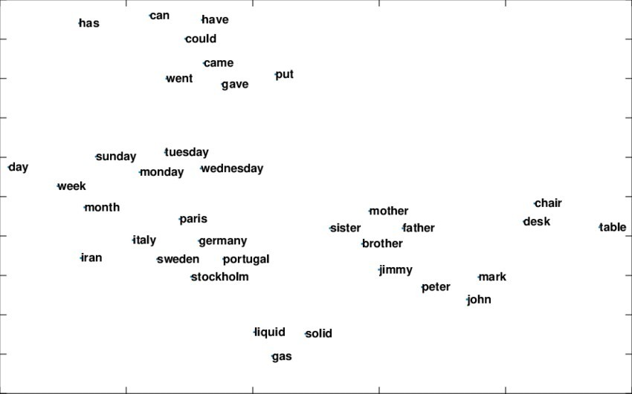
Embedding Space
Word Embeddings > Visualization
Distributional semantics methods produce close vectors for words occurring in similar contexts
Source: Ali Basirat 2018, Principal Word Vectors, PhD Thesis, Uppsala Univ.

Slide 36
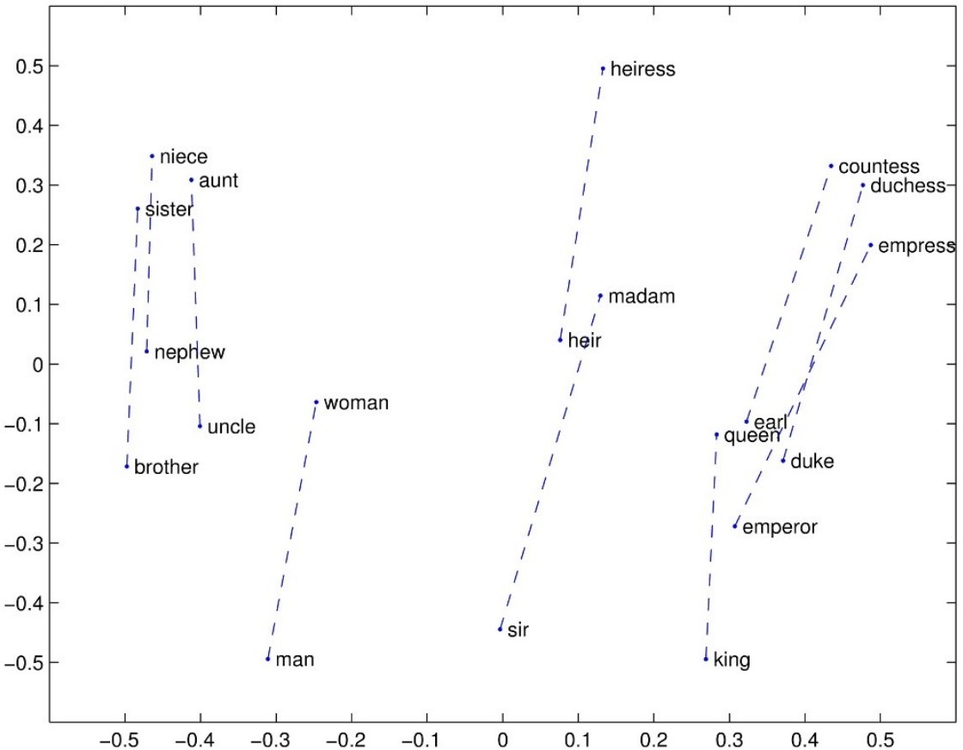
Embedding Space
Word Embeddings > Visualization
Moreover, word embeddings keep similar distance between words with the same semantic relationship.

Slide 37
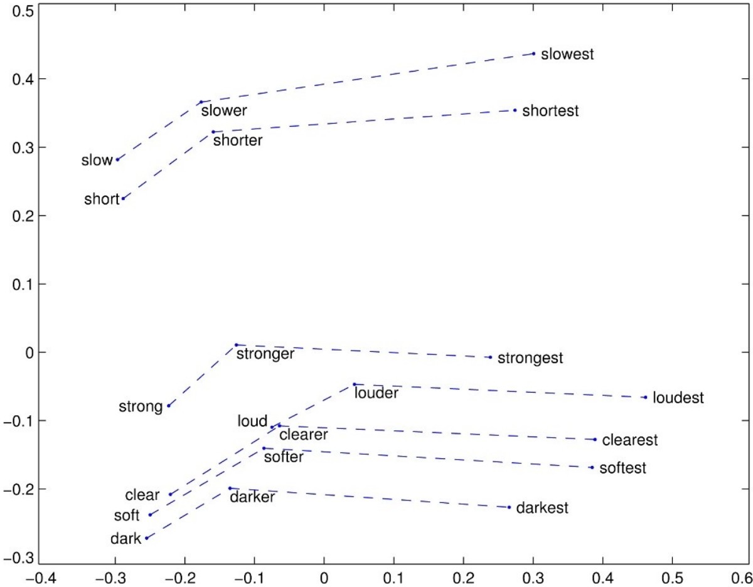
Embedding Space
Word Embeddings > Visualization
Word embeddings also keep similar distances between words with the same morphological relationship.

Slide 38
Embedding Space
Word Embeddings > Visualization
●
These spatial relations can be modeled and exploited using vector operations:
–
[wednesday] + ([tuesday] – [monday]) = [thursday] [three] + ([two] – [one]) = [four]
[three] + ([2] – [two]) = [3]
[lives] + ([knew] – [knows]) = [lived]
[this] + ([those] – [that]) = [these] [Poland] + ([French] – [France]) = [Polish] [uncle] + ([woman] – [man]) = [aunt]
–
–
–
–
–
–

Slide 39
Embedding evaluation
Word Embeddings > Evaluation
●
Intrinsic Evaluation
–
Use embeddings for tasks that can be directly evaluated
●
Similarity:
Find closest word to w:
w ⋅w
cos( w , w )= ¹ ²
1 2
∣w ∣∣w ∣
1 2
●
Analogy:
wa is to wb like wc is to <?>
Find wd that is the closest to wc+(wb-wa)
●
Extrinsic Evaluation
–
Use embeddings in downstream task (translation, sentiment analysis, text classification, etc.) and evaluate impact on task performance.

Slide 40
Limitations
Word Embeddings > Limitations
●
Compositionality: Word embeddings do not encode composited meanings such as not happy↔sad or hot dog↔sausage, since they rely on statistical co-occurrence rather than syntactic structure or adjacency.
●
Polysemy: Words like bat (animal vs. sports equipment) or apple (fruit vs. company) have a single vector in traditional embeddings, making it impossible to distinguish meanings. Contextual embeddings (e.g., BERT, ELMo) address this issue but require a different model structure. [see session 8.Transformers]
●
Rare/unseen words: Traditional embeddings assign fixed vectors to words seen during training, meaning rare or unseen words are not well-represented. Subword-based models like fastText aim to address this, but limitations still exist.
●
Hierarchical/Ontological Relationships: Word embeddings do not naturally capture strict hierarchical structures like dog→mammal→animal or part-whole relationships like wheel→car.
●
Causal/Temporal Relationships: They do not capture cause-effect relationships, such as smoking→cancer or winter→cold.

Slide 41
Contextual Embeddings
Word Embeddings > Contextual Embeddings
The same word may have different meanings in different contexts:
●
–
–
Please type everything in lowecase What type of food do you like?
Static word embeddings provide a unique representation for each word, regardless of the context. Polysemous words get mixed representations.
●
Contextual embeddings provide different representations for the same word in different contexts.
●

Slide 42
Contextual Embeddings
Word Embeddings > Contextual Embeddings
●
Contextual embeddings are trained (similarly to static embeddings) on a task that requires learning word representations.
Static word embedding models are simply a vector with the hidden layer weights for each word.
Contextual word embedding models are dynamic, and produce on- the-fly the embeddings for each word in the sentence.
This pre-trained model can be:
●
●
●
–
Straightforwardly used to compute embeddings which will be input for another task.
Fine-tuned to perform a different task.
–

Slide 43
Contextual Embeddings
Word Embeddings > Contextual Embeddings
Unlike static embeddings, contextual embeddings generate different word vectors based on surrounding context.
ELMo (2018) – BiLSTM-based, captures deep contextual & morphological info.
BERT (2019) – Transformer-based, deep bidirectional representations (MLM & NSP).
XLNet (2019) – Improves BERT using permutation-based training.
RoBERTa (2019) – Optimized BERT with more data & no NSP.
T5 (2020) – Encoder-decoder model, unifies NLP tasks in a text-to-text format.
GPT (2018–2023) – Transformer decoder (unidirectional), excels in generative tasks.

Slide 44

Thanks

